Slide 1
COP4020 – Programming Languages
Subprograms

Slide 2
Topics in this Chapter
Definitions
Design issues for subprograms
Parameter passing modes
  value
  reference
  name
  value-result
  Result
  Array (C and C++)
Generic Subprograms
Co-routines
First-class and Anonymous Functions
RPC
Activation records

Slide 3
Definitions
Subprogram implementation involves:
  Subprogram declaration – function prototype
  Subprogram definition – actions of the subprogram – the logic.
  Subprogram call – request to execute the program, an activation or invocation
Signature – subprogram name with number, order and types of parameters
Protocol – signature + return type
Prototypes – function prototypes may be required so that the compiler can do type checking
Procedure – statements that define parameterized computations. Produce results in the caller by:
  Accessing non-local variables (side effects)
  Changing parameter values (thru any of several mechanisms)
Function – semantically modeled on math functions, returning a value
  Pure functions do not modify non-local variables or parameters
  In practice, many functions have side-effects

Slide 4
Design Issues for Subprograms
What type(s) of parameter passing modes are permitted?
Are the types of the actuals checked against the formals?
Are local variables statically or dynamically allocated?
Can subprogram definitions be nested?
Are overloaded subprogram definitions allowed?
Are generic subprograms allowed?
Do functions have "first class" status?
Are anonymous functions supported?

Slide 5
Local Referencing Environments
Local variables – defined inside subprograms
  Stack dynamic:
    Advantages: flexible, necessary for recursion, efficient for storage use
    Disadvantages: inefficiencies (housekeeping and access), no history
  Static local variables
    More efficient
    Doesn’t support recursion

Slide 6
Parameters
Names for Parameters:
  Formal parameters – those in the subprogram header, in the function definition
  Actual parameters – those in the caller that invokes the subprogram
Positional parameters – correspondence between formal and actual parameters is determined by their positions in the parameter lists.
Keyword parameters
  Name of formal is specified in the actual parameter list:
  Definition: ComputeSum(Length,List,Sum);
  Invocation:
    ComputeSum(Length => My_Length,
    List => My_Array,
    Sum => My_Sum);
  Ada, Fortran 95 have them; C++, Java do not.
Default Parameter Values:
ScreenDisplay(x => 500, y => 500, others)

Slide 7
Semantics of parameter passing modes
Three models:
  Receive data from caller into callee
  Transmit data from callee to caller
  Both directions
caller
in
callee
caller
out
callee
caller
both
callee

Slide 8
Parameter Passing
Parameter Passing Modes:
  Pass by Value – a copy of the parameter is made into the callee’s activation record.
  Pass by Result – no parameter is transmitted to the program. At the end of the subprogram, the value is transmitted back.
  Pass by Reference - formal is bound to a reference to the actual.
  Pass by Value-Result - at call time formal is bound with the value of the actual. At end of call, the value of the formal parameter is copied into actual parameter.
  Pass by name – the formal parameter is bound to a Thunk (memory location) for the actual. Can be a different value each time the name is evaluated.

Slide 9
Parameter Passing in the Major Languages
Fortran 77 – pass by reference only, later value-result added
C – pass by value, explicit dereference, pass by array
C++ - pass by value, pass by reference, explicit dereference, pass by array
Java – ALL parameters are pass by value (however, most parameters are copies of references)
Ada – in, out, in-out
C# - value, ref, and out

Slide 10
Implementing Parameter Passing Methods
Pass by Value – copy contents of actual’s binding into the activation record
Pass by Result – create storage in the activation record. Write values there. At the end of the subprogram, copy the value out to the binding of the caller’s parameter
Pass by Value-Result – combines the two just described
Pass by Reference – copy the address of the actual’s binding into the activation record. Treat this binding as a pointer.

Slide 11
An Example
#include <stdio.h>
int i,j,k,m;
int main()
{
i = 1;
j = 2;
k = 3;
p1(k);
printf ("in main: i = %d, j = %d, k = %d\n", i,j,k);
}
int p1(int j)
{
k = 4;
i = i + k;
j = j + k;
printf("in p1: i = %d, j = %d k = %d\n", i,j,k);
p2(i,j);
}
int p2(int i, int m)
{
i = i + k;
m = j + 1;
printf(" in p2: i = %d, j = %d, m = %d\n",i,j,m);
}

Slide 12
Other Examples
Signatures for Swap functions in various languages:
void swap (int a, int b) // C, C++, Java
{ . . .}
void swap (int *a, int *b)
{ . . .}
void swap (int &a, int &b)
{ . . .}
procedure swap(a: in out integer,
b: in out integer) is
temp: integer;
begin . . . end swap;

Slide 13
Generic Subprograms
Generic subprograms take different types of parameters on different activations
The basic concept of a generic:
  If subprograms differ only by the names of data types or data objects, but have identical executable code, a generic unit can be compiled with the type, object, or subprogram names replaced by generic formal parameter names.
  Types are associated with actual names at instantiation
Example:
  package MY_IO is new
  INTEGER_IO(integer);
Example - Function to sort. Instantiate a generic sorting package to sort integer or float.
  Write the generic package
  Instantiate with the appropriate type

Slide 14
Generics in Ada
Example:
  generic
  LENGTH: NATURAL := 100;
  type ELEMENT is private;
  PACKAGE STACK IS
  PROCEDURE PUSH(X: in ELEMENT);
  PROCEDURE POP(X: out ELEMENT);
  FUNCTION EMPTY return BOOLEAN;
  FUNCTION FULL return BOOLEAN;
  STACK_ERROR: exception;
  end STACK;
package body STACK is
ST :array (1..LENGTH) of ELEMENT;
TOP: INTEGER range 0..LENGTH := 0;
... remainder off definitions with
100 replaced by “LENGTH”
end STACK;
then:
package STACK1 is new STACK(100,INTEGER);
package STACK2 is new STACK(64,FLOAT);

Slide 15
Generics
package body STACK is
ST :array (1..LENGTH) of ELEMENT;
TOP: INTEGER range 0..LENGTH := 0;
procedure PUSH(X:out ELEMENT) is
begin
... Code for push
end PUSH;
procedure POP(X:in ELEMENT) is
begin
... Code for pop
end PUSH;
function EMPTY return BOOLEAN is
begin
return TOP = 0;
end;
function FULL return BOOLEAN is
begin
return TOP = 100;
end;
end STACK;

Slide 16
Generics in C++
Types of Templates permitted by C++:
  Function templates
  Class templates
// generic sort function for
// insertionSort: uses comparable
template <class Comparable>
void insertionSort( vector<Comparable> & a )
{
for( int p = 1; p < a.size( ); p++ )
{
Comparable tmp = a[ p ];
int j;
for(j = p; j > 0 && tmp < a[j-1]; j-- )
a[j] = a[j-1];
a[j] = tmp;
}
}

Slide 17
C++ Generic Class
// A container for a pair of something.
template <class T>
class Pair
{
public:
Pair();
Pair(T first_val, T second_val);
void set_element(int pos, T value);
T getElement(int pos) const;
private:
T first;
T second;
};
Instantiation:
Pair<int> score;
Pair<Agile_team> team;

Slide 18
Generics in Java
public class Pair
{
public Pair(Object firstElement,
Object secondElement)
{
first = firstElement;
second = secondElement;
}
public Object getFirst() { return first; }
public Object getSecond() { return second; }
private Object first;
private Object second;
}
Pair<String, BankAccount> result
= new Pair<String, BankAccount> ("Harry Hacker", harrysChecking)
public void print(E[] list)
{
for (E element : list)
System.out.print(element + " ");
System.out.println();
}

Slide 19
Generics in Java – Typed Generics
ArrayList<BankAccount> accounts1 =
new ArrayList<BankAccount>();
LinkedList accounts2 = new LinkedList();
accounts1.add("my savings"); // Compile-time
//error
accounts2.add("my savings"); // Not detected
//at compile time
. . .
BankAccount account = (BankAccount)
accounts2.getFirst(); // Run-time error

Slide 20
Generics
Generating code for generics may be difficult
  Un-parameterized generics are simple - a new data area is created for each instance and the code is shared by all:
  Parameterized generics are more of a problem.
ST
ST
PUSH
POP
EMPTY
FULL
TOP
TOP
TOP
TOP
PUSH
POP
EMPTY
FULL
length
length
ST
ST

Slide 21
Co-routines
Master-Slave model – typical caller-callee relationship in conventional subprograms
Symmetric unit control model – caller and callee are on a more equal basis
Co-routines:
  Have multiple entry points
  Maintain state between activations
  Secondary execution may begin at other than the start of the co-routine
  At the end of execution, control goes back to the caller
Interleaved execution model: Co-routines often partially execute, transfer control to another co-routine, then resume with the statement after the one that transferred control.

Slide 22
Co-routines
Example 1:
  sub co1() {
  . . .
  resume co2();
  . . .
  resume co3();
  }
  sub co2() {
  . . .
  resume co1();
  . . .
  resume co3();
  }

Slide 23
Co-routines
Simula 67 had co-routines – useful for modeling independent processes.
Example:Simulate a card game:
  Four players – four co-routines, each embodying a playing strategy.
  Master program creates the co-routines, each with a hand of cards
  Master program resumes the first player who resumes the second etc.
Programming languages implementing co-routines.

Slide 24
The Concept of First Class Functions
First Class Functions are implemented in a programming language that supports:
  passing functions as arguments to other functions,
  returning functions as the values from other functions
  assigning functions to variables or storing them in data structures
Function names are treated like any other variable, only of type "function"
First class functions at Wikipedia

Slide 25
Anonymous Functions
A function that is not bound to an identifier
used to contain functionality that need not be named and possibly for short-term use
Often passed as an argument to a higher-order function
This feature appears increasingly in modern languages such as Javascript, Ruby, C# and PHP
Anonymous functions can help make code more concise when declaring a function that will only be used in one place. Rather than having to declare the function and then use it, you can do both in one step.

Slide 26
Anonymous Functions
Example from Javascript:
function eatCake(){
alert("So delicious and moist");
};
eatCake();
var eatCakeAnon = function(){
alert("So delicious and moist");
};
eatCakeAnon();
From:http://helephant.com/2008/08/23/javascript-anonymous-functions/

Slide 27
Remote Procedure Call
Any of the three principal forms of send (no-wait, synchronization, remote-invocation) can be paired with either of the principal forms of receive (explicit or implicit)
Rendezvous: combination of remote-invocation send with explicit receipt
Remote procedure call: combination of remote-invocation send with implicit receipt
RPC system is supported on many systems by augmenting a sequential language with a stub compiler
The stub compiler accepts as input, a description of the subroutines that are to be called remotely
Stub compiler generates source code for client and server stubs based on input

Slide 28
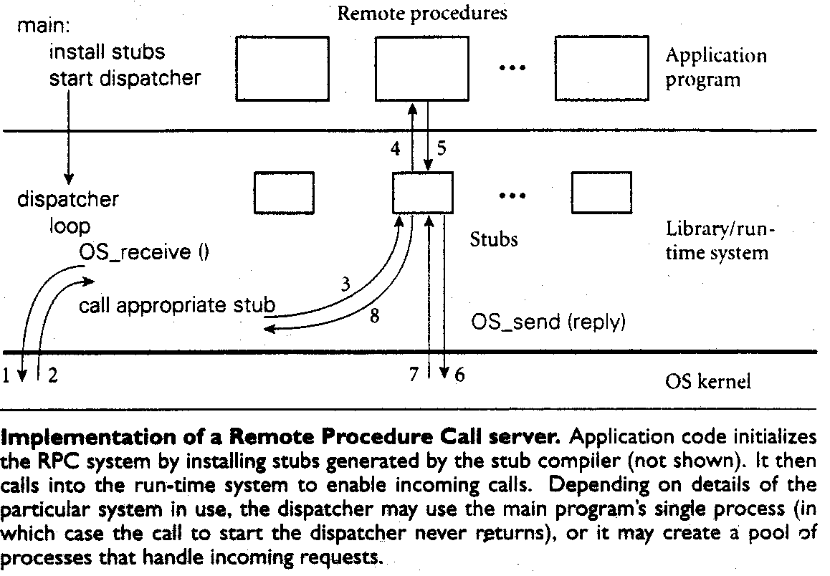
RPC System Diagram

Slide 29
The Activation Record
Stack-dynamic local variables and activation records permit recursion
A simple activation record:
A more complex activation record:
Local variables
Parameters
Return Address
Local Variables
Parameters
Dynamic link
Static link
Return address

Slide 30
Example of a Complex Activation Record
void sub (float total, int part)
{
int list[4];
float sum;
}
Local (sum)
Local (list[3])
Local (list[2])
Local (list[1])
Local (list[0])
Parameter (part)
Parameter (total)
Static Link
Dynamic Link
Return Address

Slide 31
An example
void fun1(int x) {
int y;
. . .
fun3(y);
}
void fun2(float r) {
int s,t;
. . .
fun1(s);
}
void fun3(int q) {
. . .
}
void main() {
float p;
. . .
fun2(p);
}

Slide 32
Activation records
Parameter q
Dynamic Link
Return address (fun1)
Local y
Parameter x
Dynamic Link
Return address (fun2)
Local t
Local s
Parameter r
Dynamic Link
Return address (main)
Local
AR
fun3
AR
fun2
AR
fun1
AR
main

